Slide 1
Archie-ology
Jungho Kook, Jeffrey Qiu, Juliet Ramdass, Sabrina Supapkooha

Slide 2
Content
Introduction - Inadequacies, Observations, The Customer
Market - Insights/Requirements, Opportunity/Analysis, Analogy
Game - Features and Aspects
Closing - Reflections, Q&A

Slide 3
Inadequacies of Recent “Casual” Games
“Don’t judge a book on its cover.”
Customers are given some sort of an idea of the product based on the product’s packaging.
A standard for game flow and story correlations
Aesthetically “cute” games and aesthetically “dark” games have expectations for what type of pattern they follow.
Attempts to cross categories often result in games that adopt unsettling story elements that make “cute” games “darker.”
Notes:
From bullet point #1, explain that due to this customers may sometimes overlook a product.
Some games are considered more “valid” than others
Undertale: aesthetically cute game that has a lot of difficulty. Also a game that has a heavy storyline that is revealed as you go through the game.
It’s amazing, this system produces some truly amazing games
But it also follows this pattern

Slide 4
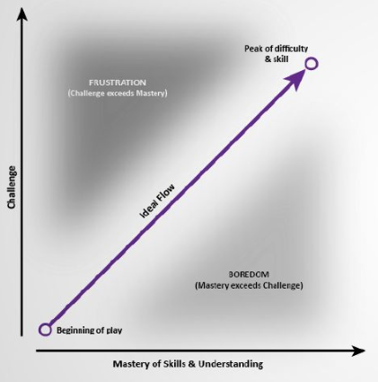
Inadequacies of Recent “Casual” Games
Emotion caused by a game’s story.
Used along with mechanics to increase challenge.
Handling the emotional factor of challenge isn’t always enjoyable.
It shouldn’t be the only option for players looking for more challenging adventure games.
There are many people that don't find games that are emotionally heavy appealing.
Notes:
Game flow is based on the ratio of game difficulty and player’s skill
The ideal curve was developed in the 70s
Many interesting games have been made with more diverse curves
Games that challenge us in this way are important but they shouldn’t be the only option

Slide 5
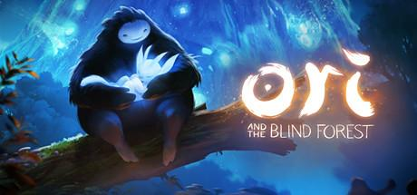
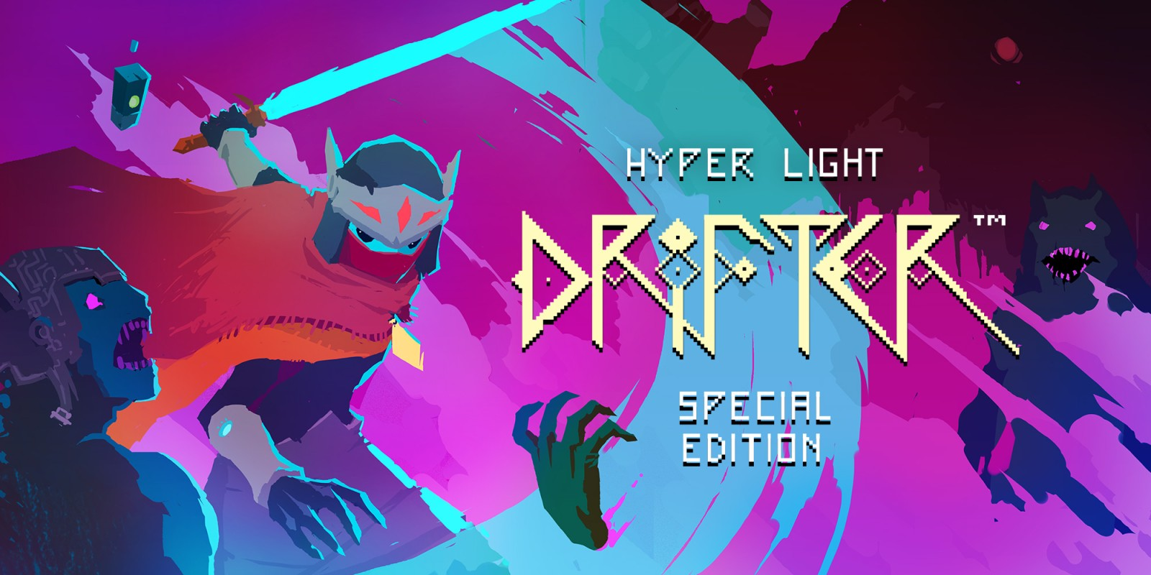
Observations
Challenging games are often deemed “not challenging” due to their design and aesthetics.
Hollow Knight, Ori and the Blind Forest vs. Dead Cells, Hyper Light Drifter
Some players have not moved from the idea that “cutesy” games equate to “kiddie” games.
Notes:
Hollow Knight, Ori and the Blind Forest = pretty games, there easy games when in actuality their play difficulty is on par with more edgy games such as hyper light drifter and dead cells.
Unfortunately, due to their whimsical designs, Hollow Knight and Ori are overlooked as “child-friendly” games (in terms of difficulty), and thus causes of players who FAVOR these types of games to miss out playing them.

Slide 6
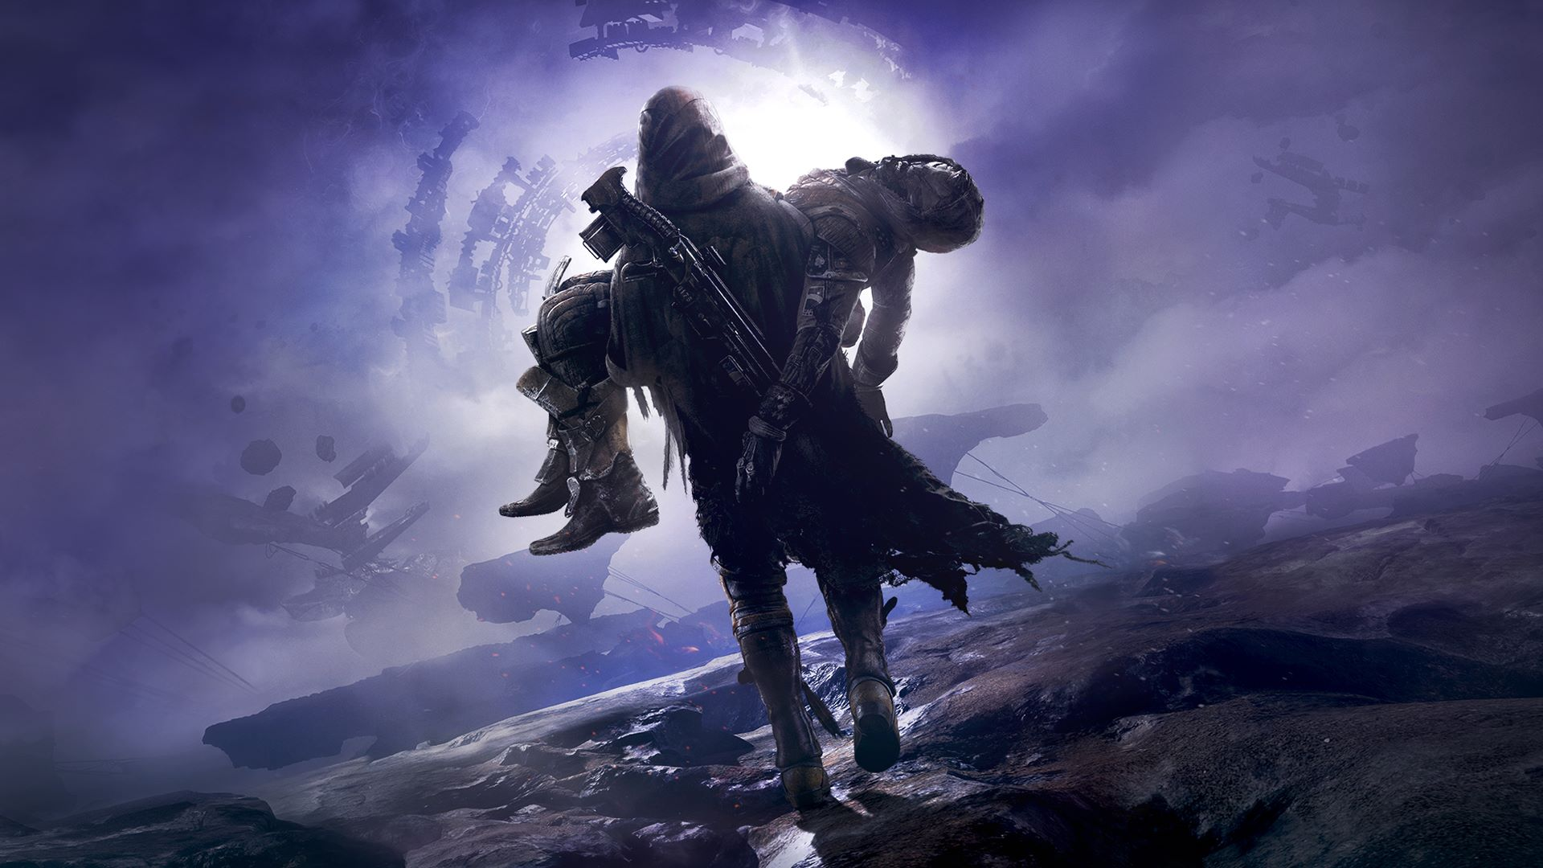
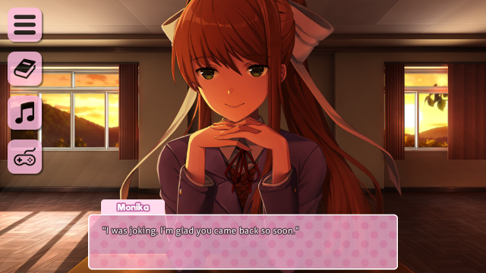
Observations
Games with a “cutesy” design receive attention after reviews. Whereas, games with a ruggish design receive attention before and after reviews.
Doki Doki Literature Club vs. Destiny
Reputation usually divides the community
Playing “cute” games needs to be justified in the larger gaming community.
Usually a challenging story is used for this rather than challenging mechanics.
Cover art of Destiny 2: Forsaken and a screenshot of Doki Doki Literature Club
Notes:
People are unwilling to play some very good games because of their biases based on aesthetics
People who can’t handle heavy games end up being excluded from challenging games
People with anxiety
People looking for a peaceful escapism
People looking for distraction that isn’t violent

Slide 7
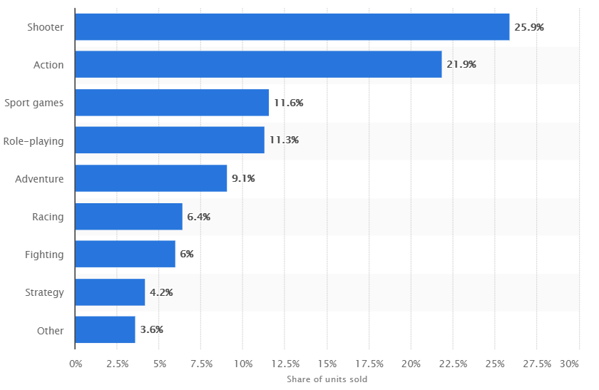
The Customer
Video Game Sales:
In 2015
Adventure was 5.9%
Action was 4.1%
Shooter is 6.3%
In 2017
Adventure is 9.1%
Action is 21.9%
Shooter is 25.9%
Notes:
Adventure games have been shown to
increase focus
provide stress relief
Improve multitasking
Help with dyslexia (Source: https://www.sciencedaily.com/releases/2013/02/130228124132.htm)
Not many are being released compared to more violent games
IMPORTANT FACT OF SLIDE: Adventure games can grow in popularity if they become less of a commitment to players.

Slide 8
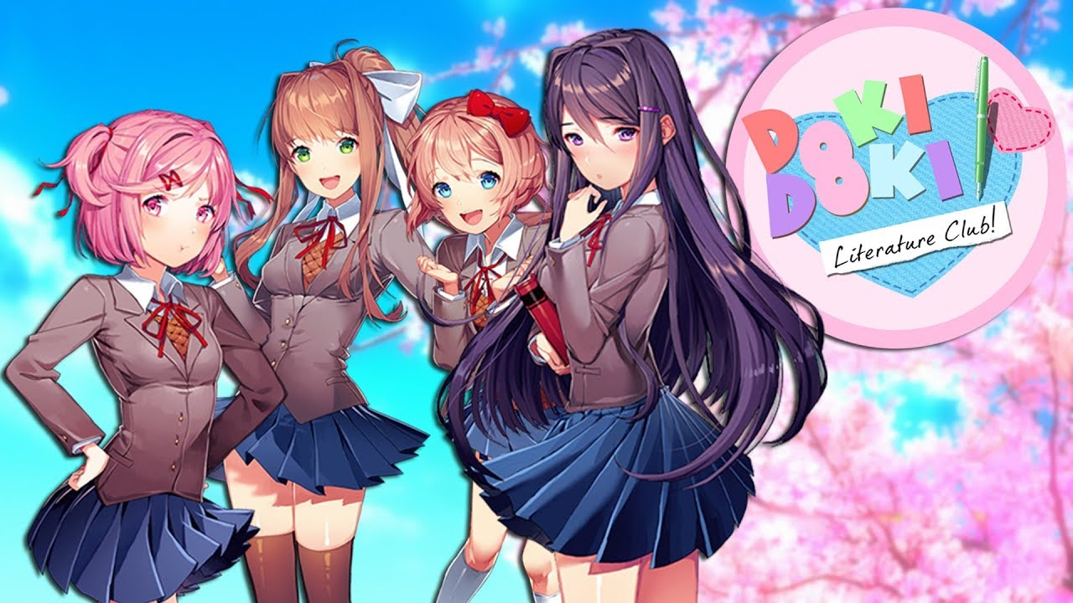
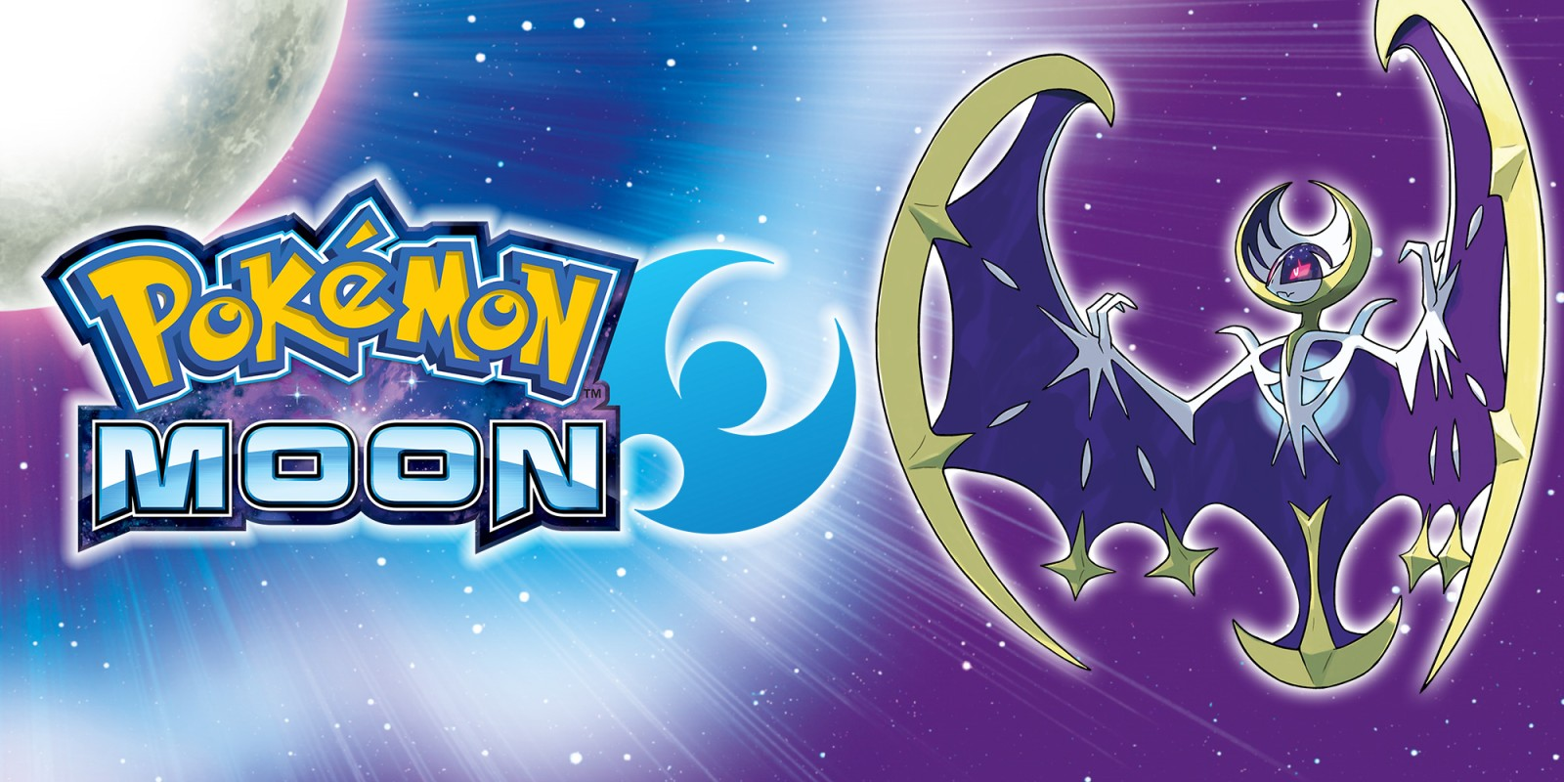
The Customer (Scenarios)
Scenario #1: Fear Of Missing Out (F.O.M.O)
Overlooking a game only to later learn that it is the game that everyone is talking about.
Scenario #2: So much plot, not enough time
Gameplay is purely story driven, thus requires a moderate amount of time to play and make progress.
Notes:
Doki Doki Literature Club: did NOT seem like anything other than a typically dating sim/visual novel game; several days after release, the gaming community explored with reviews and recommendation for the game, stating that it is not as innocent/cute as it seems. Players who finished the game recommended that new players play at least until 3 hours in, therefore implying that something happens within 3 hours. This bit of information along with other media platforms that were discussing the game ultimately to some spoilers which ruins the game for new players; therefore discouraging them from playing.
Pokemon is purely story driven since some sections of the game cannot be accessed until the player meets certain condition within the storyline itself (for example, one area may be deemed not available solely because the player has yet to meet a specific NPC related to that area). This coupled with the slightly restrictive leveling system the game implements cause the game to require a moderate amount of time to play. It is not a game that one can put down and pick up sometime later because the player would have most likely bits of the story that were key to progression (i.e. needing to find an item but not remembering the item name or the hints given to find it). Thus, it discourages players, especially older players with busy schedules, to continue playing the game.

Slide 9
Insight - Requirements
Action and Shooting games have fast paced action
Sales have increased since 2015
Adventure games are normally slower
Have a long story to tell
Time consuming because of it
Sales for these kinds of games are affected as we move into a faster, modern world

Slide 10
Opportunity - Analysis
Many “casual” gamers do not have the time to invest in a story.
Many people play as a way to escape reality and to have some fun.
Our game can help change perceptions about “cute” games and the accessibility of adventure games in the market.
Notes:
This is the market we can fill
Go into describing the game on next slide

Slide 11
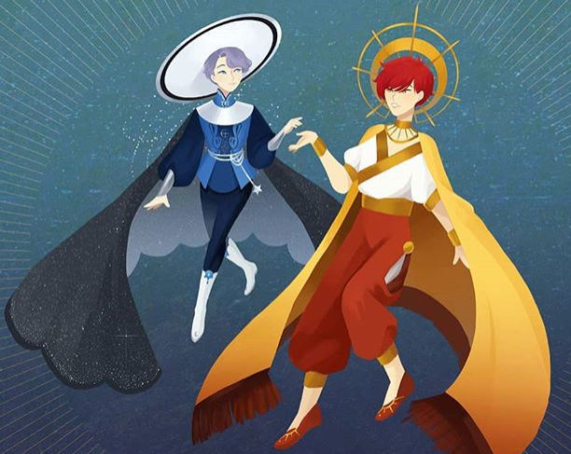
Archie-ology
Adventure Platformer game where you play as a cat named Archie
Atmosphere and mechanics
You can explore a colorful world full of collectables and unique characters
Lots up obstacles to bypass and treasures to find
Some collectables unlock more movement mechanics
Unlocking mechanics in different orders change how the game can be played
Art by one artist in contact with our team
Notes:
Treasures and obstacles provide small bits of lore and aesthetically pleasing visuals
The map can be explored in different orders per game
Makes for lots of replayability
Different mechanics and creative problem solving are necessary

Slide 12
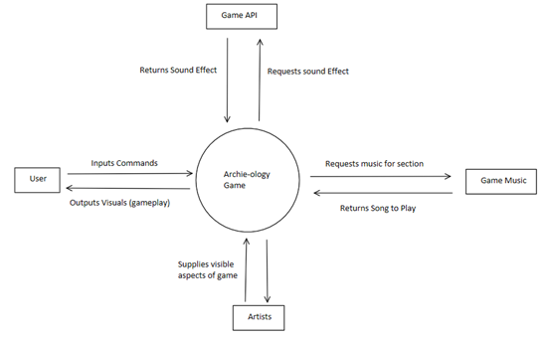
Context Diagram
Notes:
Like any game, the user will input commands to the game program have the program output gameplay.
We have a few external systems which include the game music library, sound effect library and the artwork for the game. These are requested by the game engine as they are needed. This

Slide 13
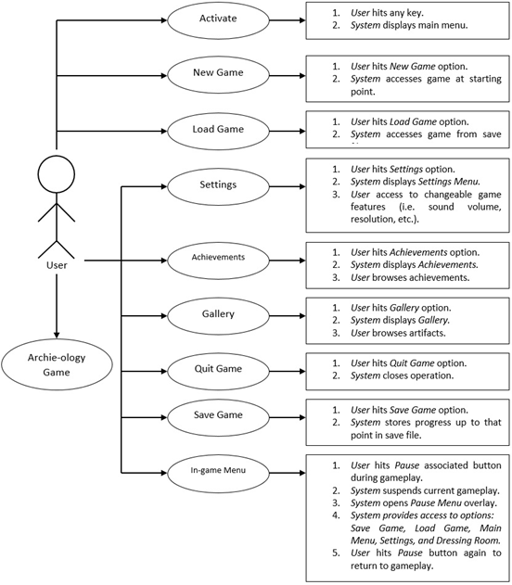
Use Cases
Notes:
Here are our use cases. Many of these use cases include various ways of navigating through menu screens.

Slide 14
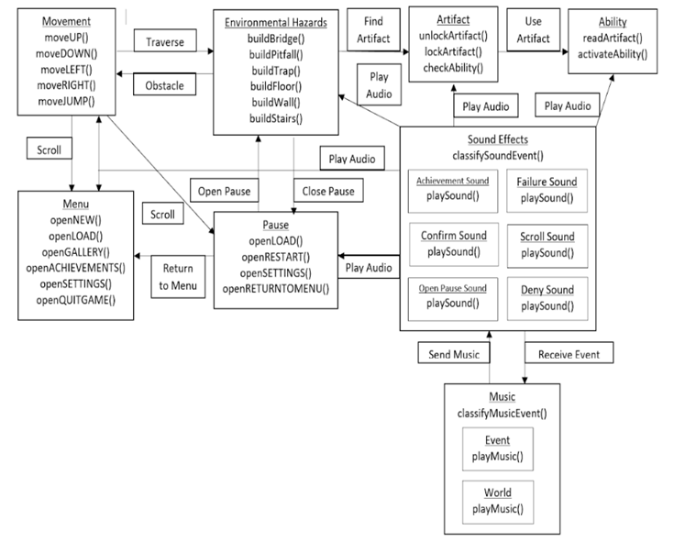
Class Relationship Diagram

Slide 15
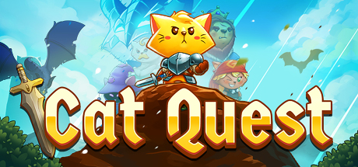
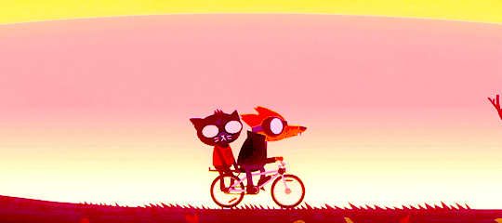
Features and Aspects
Peaceful escapism for older gamers
Provides challenging gameplay
Engaging and light-hearted story
Emphasis on gameplay via quests (achievement system)
Narrative is a secondary mechanic that enhances gameplay
Evoke an immersive and charming atmosphere with audio and visual
Blend of 2D art and animation
Quaint dialogue and storytelling
Notes:
Peaceful escapism: challenging gameplay = pokes at player’s desire to reach the satisfaction of accomplishing a difficult task
Psychologists call it “intrinsic motivation”—the urge to make progress toward a goal without the promise of an externalized reward. In other words, if you find yourself doing something regardless of whether you’ll be paid, acknowledged or otherwise compensated in exchange for doing it, you are intrinsically motivated.
An easy to digest story that subtly focuses on wholesome topics, such as family and companionship. Does not compromise gameplay, but adds motivation behind the player’s actions to finish a goal (i.e. retrieve an artifact for Archie’s owner to bring a smile to their face)
2D art and animation: colors and audio will reflect the mood and intensity of the scene/world (i.e. When Archie begins his adventure, the music picks up from solemn (since he was brooding over what to do for his owner) to bright and out-going (since he find resolve to bring his owner artifacts from the outside world).
2D modeling and sprites of characters will help convey the emotion of the dialgue (i.e. happy dialgue = Archie is smiley)

Slide 16
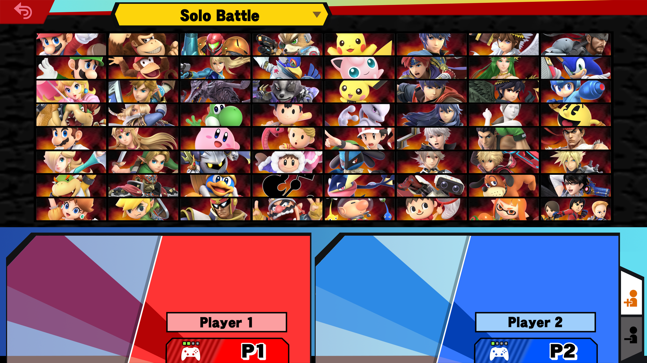
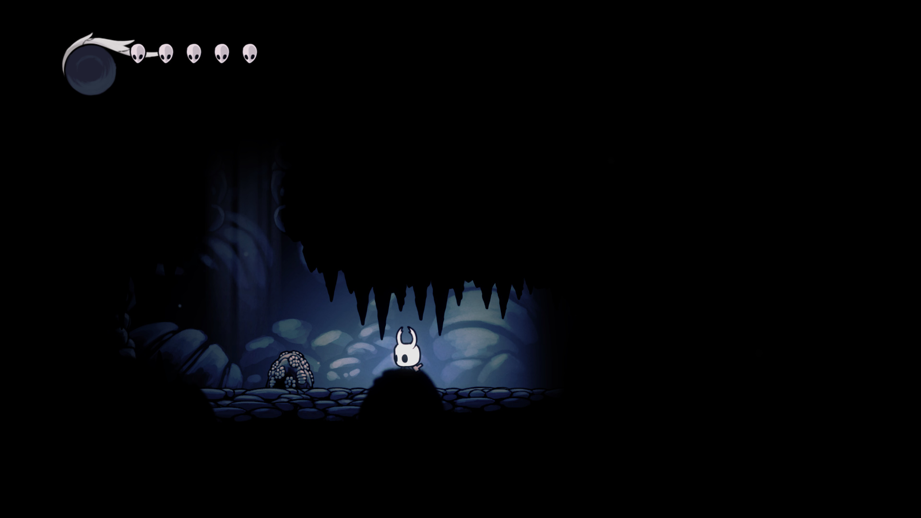
Future Work
Expand to different consoles
Nintendo Switch, PS4, Xbox One
Make the world bigger
More worlds, artifacts, abilities
Possible new characters
Additional playable characters (i.e. dog)
Additional NPCs with quests
Implementation of different game modes
“Hard” mode - adds enemies
“Speed” mode - speedrun
“Blind” mode - smaller field of vision
Notes:
Nintendo Switch: the online shop has plenty of games that target younger audiences in the aspect that the games pose a challenge to children, but not to adults
PS4/XBox One: the online shops haves several indie titles that have gained repertoire as challenging games due to their mechanics and gameplay rather than story (i.e. hyper light drifter, enter the gungeon, ori and the blind forest)
Bigger world: creation of new locations/worlds calls for new artifacts/abilities
Implementation of modes: enemies, speedrun, etc.
Additional content would be marketed as DLCs.
New characters: players can change the player character to a different animal, such as a turtle or dog. Likewise, there will be new NPCs that players can interact with (this NPCs will most likely be related to the new worlds)

Slide 17
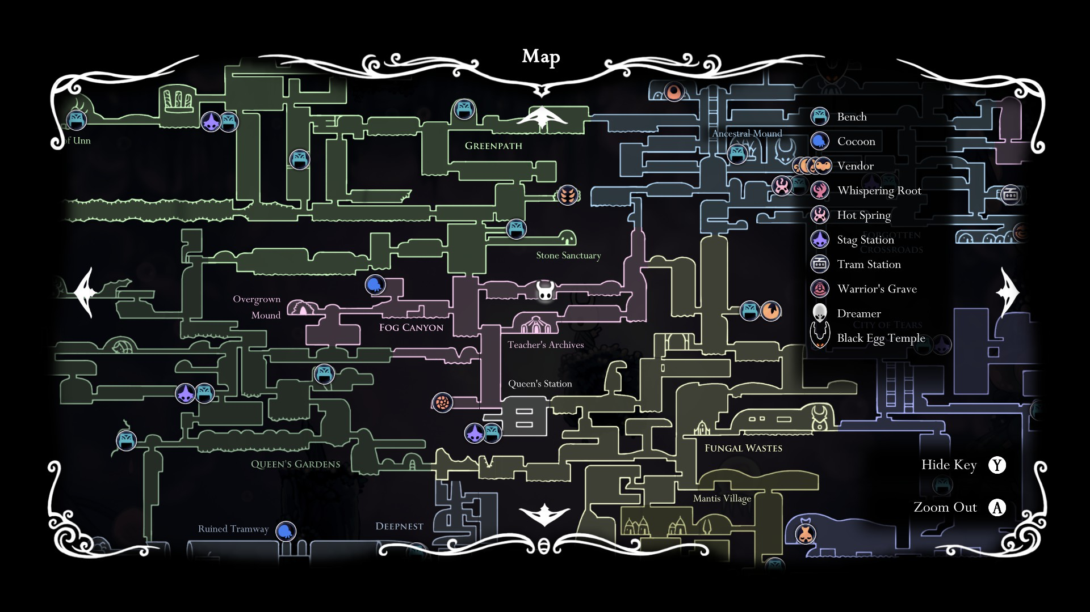
Future Work
Notes:
Nintendo Switch: the online shop has plenty of games that target younger audiences in the aspect that the games pose a challenge to children, but not to adults
PS4/XBox One: the online shops haves several indie titles that have gained repertoire as challenging games due to their mechanics and gameplay rather than story (i.e. hyper light drifter, enter the gungeon, ori and the blind forest)
Bigger world: creation of new locations/worlds calls for new artifacts/abilities
Implementation of modes: enemies, speedrun, etc.
Additional content would be marketed as DLCs.
New characters: players can change the player character to a different animal, such as a turtle or dog. Likewise, there will be new NPCs that players can interact with (this NPCs will most likely be related to the new worlds)
Hollow Knight map: example of what a full map of game would look like (with DLCs); different colors = different worlds/environments; legend showcases that each location has events that other locations do not.

Slide 18
Reflection
What did we do right | What we did wrong | What we would change
Team communication Clear general focus Productive and open discussions Democratic decision-making | Not enough defect checking Doing things last minute Too many ideas, too little specifications (of prior ideas) | Plan to start things early Check defects before submission Make deadlines Improve inspection and peer review
Notes:
Right: communication is flowing swimmingly, decisions are discussed and decided as team, team members are comfortable enough to voice opinions that may/may not align with the group’s status quo; these are discussed evenly and sometimes lead to improvements
Wrong: Defecting checking is lackluster, procrastination, coming up with new ideas before fully forming/establishing old ones,
Change: Planning ahead and assigning deadlines, checking before submitting deliverables, improve quailty of work through better inespections and peer reviews

Slide 19
The
End
Questions?

